Slide 1
Texas Coal Ash Utilization Group Austin – Hilton Garden Inn
Coal Combustion Residuals (CCR) Update Will Wyman Waste Permits Division May 13, 2015

Slide 2
Topics to be covered
Overview
Background
Applicability
Technical Requirements
Timelines
Federal Legislation
State Issues
Notes:
Topics to be covered:
This presentation will cover the latest on the Coal Combustion Residual (CCR) rule and how it impacts Texas.
Please hold questions to the end - We’ll have a group of folks to answer questions.
Bob Patton is the POC for CCR for the Office of Waste and he is in contact with EPA HQ, Region 6, and ASTSWMO which stands for the Assn of State and Territorial Solid Waste Mgmt Officials.
Other people on the team include myself Vahab Haghighatian, Mary Talley and legal staff.

Slide 3
EPA CCR Rule Overview
The EPA rule establishes nationally applicable minimum criteria for the disposal of CCR in landfills and surface impoundments
CCR, also known as coal combustion residuals, coal combustion waste or coal ash is generated from burning coal for the purpose of generating electricity by electric utilities and independent power producers
CCR includes fly ash, bottom ash, boiler slag, and flue gas desulfurization (FGD) materials
Notes:
Rule is self implementing; no action by a regulator is needed before a facility must comply.
•Citizens and states can enforce the requirements under RCRA citizen suit authority.

Slide 4
EPA CCR Rule Overview
Initial Rule Proposal June 21, 2010.
On December 19, 2014, the Administrator signed the Final Coal Combustion Residuals (CCR) Rule issuing pre-publication of the rule
April 15, the House Energy and Commerce Committee passed H.R. 1734, Improving the Coal Combustion Residuals Regulation Act of 2015
On April 17, the final CCR rule was published I
in the Federal Register
Notes:
The final rule is effective October 19, but be very careful because for example.
257.51 Effective date of this subpart.
The requirements of this subpart take
effect on October 19, 2015.
But through out the definitions EPA uses language such as
Existing CCR landfill means a CCR
landfill that receives CCR both before
and after October 14, 2015,

Slide 5
CCR Background
In 2010, Two regulatory options were proposed
EPA finalized the rule under a subtitle D, non-hazardous waste provisions of RCRA 40 CFR 257.50 – 257.107
CCRs remain Bevill exempt. 261.4 (b)(4)
Notes:
Subtitle C hazardous waste landfills
Hazardous and Subtitle D – non hazardous solid waste provisions. In Texas these wastes currently require an industrial waste notification.
SOLID WASTEs which are not HAZARDOUS WASTES
Bevill exempt - this was widely commented on to congress and in the draft rule. A no decisions was made on making a conrcrete Bevill exemption wastes which are not hazardous wastes

Slide 6
Applicability
Owners and operators of:
New and existing CCR landfills
New and existing CCR surface impoundments
Any lateral expansions of CCR landfills or surface impoundments
Inactive CCR surface impoundments located at active utilities
Notes:
NAICS 22122 – active electric utilities and independent power producers.
Other - disposal units off site. Inactive CCR surface impoundments at active electric utilities or independent power producers regardless of current fuel use. Inactive is not closed.

Slide 7
Applicability
Does not apply to:
Landfills that have ceased receiving CCR prior to the effective date of the rule October 14, 2015.
CCR units at facilities that have ceased producing electricity prior to the effective date of the rule
CCRs from non-utility boilers (i.e., universities, hospitals)
Notes:
JUST INFOMRATION DON’T READ - for the purpose of generating electricity unless the fuel burned consists of more than fifty percent (50%) coal on a total heat input or mass input basis, whichever results in the greater mass feed rate of coal.
Existing CCR landfill means a CCR landfill that receives CCR both before and after October 14, 2015, or for which
construction commenced prior to October 14, 2015 and receives CCR on or after October 14, 2015. l

Slide 8
Applicability
Does not apply to:
CCR placement at active or abandoned underground or surface coal mines
CCRs that are beneficially used
MSWLFs that receive CCR for disposal or use as daily cover (temporary authorization and modification with notice)
Notes:
SLOW down

Slide 9
Beneficial Use of CCR
The rule does not apply to practices that meet the definition of beneficial use
Provides a functional benefit
Substitutes for the use of a virgin material
Meets relevant product specifications, regulatory standards, or design standards when available

Slide 10
Beneficial Use of CCR
Un-encapsulated use of CCR
>12,400 tons non-roadway applications placed on the land, the user
The user upon request must demonstrate and provide information that environmental releases to any media are comparable or lower than products made without CCR
Releases will be below health-based benchmarks for human and ecological receptors

Slide 11
Beneficial Use of CCR
Six months after publication of the rule sites will need to determine if they comply with the criteria contained in the definition of “beneficial use of CCR.”
Rule does not affect existing beneficial use applications, only planned applications
TCEQ Rule 30 TAC 335.1 (140)(H).
8 non-waste criteria rule
Notes:
Beneficial Use of CCRs
Rule provides a definition of beneficial use to distinguish between beneficial use and disposal.
Rule does not affect beneficial use applications that have started before Effective Date.
Placement of CCR in sand and gravel pits constitutes disposal, rather than beneficial use.
CCRs that meet the TCEQ “eight-criteria rule” are exempt from the definition of solid waste [30 TAC 335.1 (140)(H)]. Self implementing. For placement of recyclable non hazardous material on the land.

Slide 12
Technical Requirements Overview
National minimum criteria consists of:
Location restrictions
Design standards
Operating standards
Groundwater monitoring
Corrective action
Closure and post closure care
Recordkeeping/notification and internet posting*
Notes:
This is a high level discussion of the technical requirements of the rule
Just a reminder of our team Vahab, Mary, Bob and legal. SEE EPAs website for a webinar on March 4, for more details. I SHARE THE LINK AT THE END OFN THE PRESENTATION

Slide 13
Location Restrictions
Five location restrictions for CCR Landfill and Impoundment Units:
Placement above the uppermost aquifer
Wetlands
Fault areas
Seismic impact zones
Unstable areas
Existing CCR landfills - subject to unstable area criteria only
New CCR units, existing CCR impoundments & lateral expansion of CCR units - subject to all five restrictions
Notes:
Units are prohibited from being sited in these areas unless specific demonstrations can be made.
• Demonstrations must be certified by a qualified PE
SLOW

Slide 14
Design Standards - Liners
New CCR units are required to have:
Composite or alternative composite liners
Leachate collection and removal system (only for CCR Landfills)
Existing CCR landfills:
Regardless of liner type can continue to operate

Slide 15
Liners - Continued
Existing CCR surface impoundments:
Must identify liner design as one of the following:
Composite,
Alternative composite
2-foot layer of compacted soil with hydraulic conductivity no more than 1x10 ⁻⁷
Will be designated as “unlined” if they do not meet any of the 3 criteria for liner types or can not make a designation within the specified time frame (18 months)
Notes:
Existing CCR surface impoundments that do not meet any of these three criteria for liner types or fail to make the designation within the specified timeframe are to be designated as “unlined.”
• Existing “unlined” CCR surface impoundments that, as a result of leakage, exceed a groundwater protection standard must retrofit or close in accordance with requirements of the rule.
Existing “unlined” CCR surface impoundments that, as a result of leakage, exceed a groundwater protection standard must retrofit or close in accordance with requirements of the rule.

Slide 16
Design Standards – Structural Integrity
All CCR surface impoundments must:
Identify unit with a permanent ID marker
Conduct periodic hazard potential classification assessment
Develop an Emergency Action Plan if unit is designated as “high” or “significant” hazard
Cover embankment or dike slopes
Notes:
Conduct periodic hazard potential classification assessment.
• High hazard
• Significant hazard
• Low hazard
– Develop an Emergency Action Plan (EAP) if unit is designated as a “high” or “significant” hazard.
– Cover embankment or dike slopes with either vegetation or an alternative form of slope protection.
No later than, December 17, 2015,the owner or operator of the CCR unit must place on or immediately adjacent to the CCR unit a permanent identification marker, at least six feet high showing the identification number of the CCR unit, if one has been assigned by the state, the name associated with the CCR unit and the name of the owner or operator of the CCR unit.

Slide 17
Design Standards – Structural Integrity
Surface impoundments that exceed a specified size threshold have additional requirements:
Compile a history of construction or design and construction plans
Conduct periodic structural stability assessments
Conduct periodic safety factor assessments
Units that fail to meet factors of safety or fail to conduct the assessment must initiate closure
Notes:
Complete the initial hazard potential classification assessment, structural stability assessment, and safety factor assessment within
18 months AFTER rule publication
Slow down

Slide 18
Operating Standards
Operating standards include:
Fugitive dust control (fugitive dust plan, annual report)
Run-on/run-off for landfills (RORO) prepare initial (RORO) plan and revise every 5 years
Hydrologic and hydraulic capacity requirements for surface impoundments (prepare initial and period inflow design flood control plan)
Inspections for surface impoundments and landfills (weekly, monthly, and/or annual inspections)
Surface impoundment inspections: see handout on time frames 6, 6, 9 months
Notes:
Prevent flow onto the active portion of the CCR unit during the peak discharge from a 24-hour, 25-year storm.
– Collect and control at least the water volume from a 24-hour,
25- year storm.
• O/O must prepare an initial RORO control system plan within 18 months of rule publication and revise these plans at a frequency no greater than every five years.
• RORO control system plans must document system design and construction, including engineering calculations.
the Office of Waste will work with industry on the development of the SWMP and any time of possible permitting program. During that phase, discussions should include the format of the reports, how often to submit, and who to send them to (IHW).

Slide 19
Groundwater Monitoring
All surface impoundments (inactive that haven’t closed), landfills and lateral expansions must:
Install a groundwater monitoring system and conduct monitoring
Be in compliance with requirements within 2 years of the effective date
Post an annual report, including data, certifying compliance on the website
Meet groundwater requirements throughout active life and closure/post closure period.
Notes:
Includes inactive impoundments that haven’t closed.
Must be in compliance with requirements (up through detection monitoring and determination of background levels) within two years of effective date of the rule.
• Requires an annual report certifying compliance, including data, to be posted on facility’s website.
• Groundwater requirements must be met throughout active life and closure/post closure period
more reporting requirements to be determined during the development and approval of the state SWMP

Slide 20
Corrective Action
Must include an analysis of the effectiveness of potential corrective measures.
Must discuss the assessment in a public meeting before selecting remedy.
Remedies must attain the groundwater protection standard for 3 consecutive years and control the source(s) of release
Specify a schedule for implementing and completing remedial activities
Initiate remedial activities within 90 days of selecting a remedy
Notes:
Corrective action - Once a groundwater monitoring system and groundwater monitoring program has been established for a CCR unit, the owner or operator must conduct groundwater monitoring and, if the monitoring demonstrates an exceedance of a groundwater protection standard for any of the identified constituents in CCR, must initiate corrective action.

Slide 21
Closure
Closure of a CCR unit is triggered in one of three ways:
1. Unit fails to meet technical criteria:
. Location restrictions
. Leaking, unlined CCR surface impoundment
. Fails to demonstrate or meet structural integrity standards
2. When the known final waste shipment or when the last known volume of CCR for beneficial use is removed
3. When a unit is “idle” for more than two years (no receipt of CCR or removal of CCR for beneficial use)
Notes:
R

Slide 22
Closure (continued)
Owner/Operator (O/O) must prepare closure and post-closure care plans
Closure of a CCR unit must be completed either by:
leaving the CCR in place and installing a final cover system; or
Removing the CCR and decontaminating the unit (clean closure)
Rule establishes timeframes to initiate and complete closure activities (extensions are available)
Notes:
Rule establishes timeframes to initiate and complete closure activities, and authorizes the
O/O to obtain time extensions due to circumstances beyond the facility’s control:
– CCR landfills must complete closure within six months, with the possibility of one two- year extension.
– CCR surface impoundments must complete closure within five years, WITH POSSIBLE EXTENSIONS BASED ON THE SIZE OF THE IMPOUNDMENT
• Rule also establishes alternative closure procedures in situations where an owner or
operator has no alternative disposal capacity or is permanently closing the coal-fired boiler in
the foreseeable future.
• Extensions are not available for units that fail to demonstrate or meet factors of safety.

Slide 23
Post Closure
Owner Operator O/O that “clean close” are not subject to these provisions
O/O of inactive units or units that “clean close” that close within three years are not subject to these provisions
O/O must prepare a post closure plan
Notes:
Owners or operators must continue post-closure care for 30 years:
– If, however at the end of 30 years, the unit is operating under assessment monitoring, the O/O must continue to conduct post closure care until the O/O returns to detection monitoring.

Slide 24
Post Closure (continued)
Following closure, O/O must:
Maintain integrity and effectiveness of final cover system;
If applicable, maintain integrity and effectiveness of leachate collection and removal system; and
Maintain groundwater monitoring system and continue monitoring groundwater
O/O must continue post-closure care for 30 years that includes groundwater monitoring
Notes:
Slow

Slide 25
Recordkeeping, Reporting and Website
O/O are required to document how the provisions of the rule are being met by placing information in an operating record and providing notification to States
O/O must establish and maintain a publicly accessible internet site that posts documentation
Files must be maintained in the operating record and on the internet site for 5 years
Emergency Action Plan, current fugitive dust control plan, and the current written closure plan must be maintained as long as the facility remains active
Notes:
Owners or operators are required to document how the provisions of the rule are being met by placing information in an operating record and providing notification of these actions to the State Director/or the appropriate Tribal authority.
• Owners or operators must also establish and maintain a publicly accessible internet site that posts documentation that has in many instances also been entered into the operating record.
• Most files must be maintained in the operating record and on the internet site for five years.
• As long as the facility remains active, the following documents must be maintained:
– Emergency Action Plan
– Fugitive Dust Control Plan
– Closure Plan
• State Directors and/or appropriate Tribal authority may request any demonstration or documentation required by the rule if such information is not available via the facility’s publicly accessible internet site. THIS WILL BE BETTER DEFINED IF THE STATE SUBMITS A SWMP
The federal bill allows the permitting authority to post this information

Slide 26
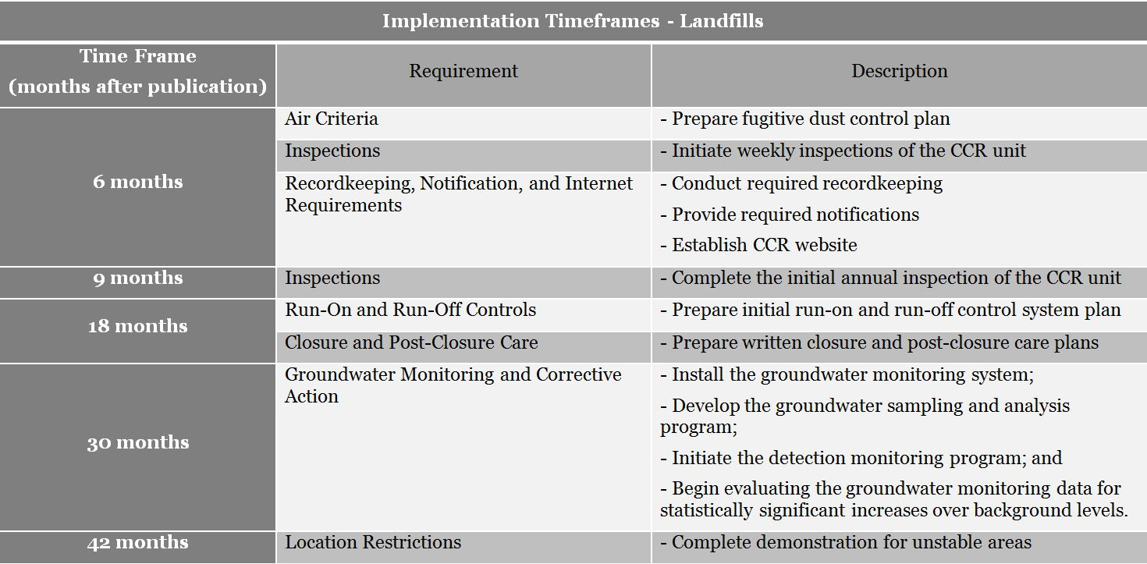
Implementation Timeframes - Landfills
Notes:
SEE ADDITONAL HANDOUT
Major Impact on Existing Units - Requires that the existing CCR surface impoundments and landfills meet the established technical criteria within specified timelines ranging from six to 42 months of the publication date of final rule.
With some exceptions (i.e., fewer location and no liner restrictions for existing CCR landfills), the same technical standards as new units are required for existing CCR units.
Major Timelines:
Impoundment liner demonstration (18 months)
Impoundment structural integrity (24 months)
Groundwater monitoring (30 months)
Location demonstration (42 months)
Utility must show compliance with the established standards within 42 months of the publication date of final rule or begin closure of the CCR units no later than 48 months of the publication date.

Slide 27
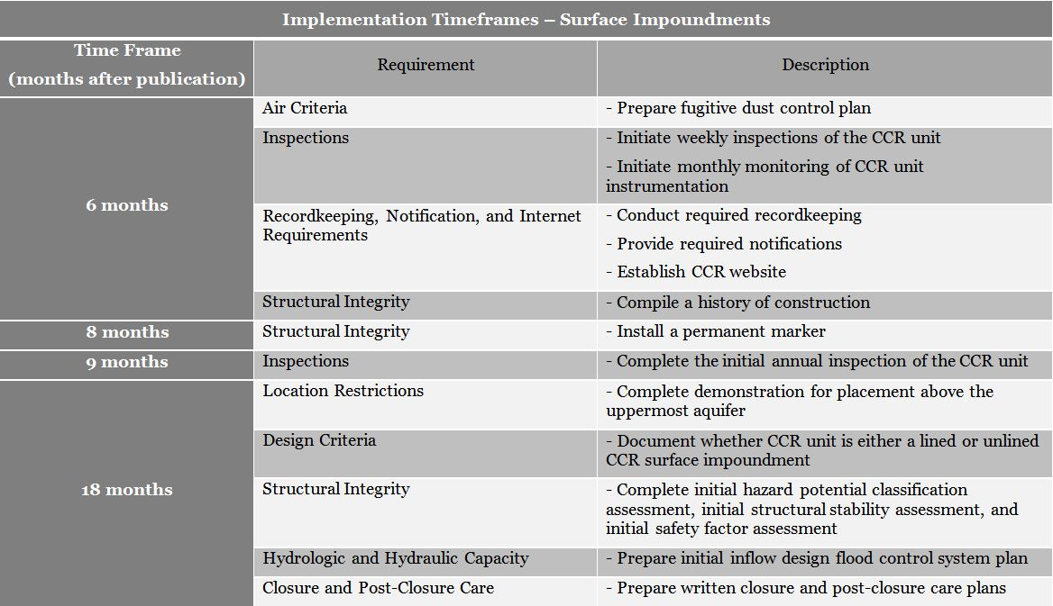
Implementation Timeframes - Surface Impoundments
Notes:
This graphic is a display of timelines for CCR Surface Impoundments found in the preamble and rule.

Slide 28
Implementation Timeframes – Surface Impoundments (contd.)

Slide 29
H.R. 1734 – (see handout)
On April 15, the House Energy and Commerce Committee passed H.R. 1734, Improving the Coal Combustion Residuals Regulation Act of 2015 (See Fact Sheet)
Authorizes states to implement a permiting program under the timelines discussed in the draft bill. If a state opts out of permitting program EPA will implement a permit program. Uses the same technical requirements as the EPA rule.
States can make a permitting program more flexible and more protective than minimum federal requirements
Differences from EPA Rule
Notes:
Not going to cover too much since this is pending congressional legislation
Notification - Not later than 6 months after the date of enactment of this section /bill, the Governor of each State shall notify the Administrator , in writing, whether such State will adopt and implement a coal combustion residuals (CCR) permit program;
Differs from EPA rule - PERMIT PROGRAM, FINANCIAL ASSUREANCE INTERNET POSTING, ENFORCEMENT financial assurance, internet postings, enfoment
You can sign up for email updates from the House Energy and Commerce Committee

Slide 30
State Issues
States are not required to adopt the CCR rule.
States are encouraged to submit a Solid Waste Management Plan to demonstrate how states plan to address CCR Standards.
EPA approves plans that at a minimum “meet the requirements of EPA’s guidelines” – 6 months
EPA regulations require states to develop their plans through a public notice and comment process
23 states/territories currently with full plan approvals including Texas
Notes:
States with approved SWMPs can limit their submission to information related only to CCRs.
States will need to provide enough information about any needed revisions to allow a reasonable review.
•Approval would be conditioned on final adoption of revised regulations, no additional submittal or approval process is required.
–EPA must make approval decision in 6 months after receipt.
Checklists will be used to inform discussions between states and regional offices.
the Office of Waste will work with industry on the development of the SWMP and any time of possible permitting program. During that phase, discussions should include the format of the reports, how often to submit, and who to send them to (IHW).

Slide 31
State Issues
Texas Health and Safety Code, Solid Waste Disposal Act, Sec. 361.090
REGULATION AND PERMITTING OF CERTAIN INDUSTRIAL SOLID WASTE DISPOSAL
(a) The commission may not require a permit under this chapter for the collection, handling, storage, processing, and disposal of industrial solid waste that is disposed of within the boundaries of a tract of land that is:(1) owned or otherwise effectively controlled by the owners or operators of the particular industrial plant, manufacturing plant, mining operation, or agricultural operation from which the waste results or is produced; and(2) located within 50 miles from the plant or operation that is the source of the industrial solid waste
.
•
Notes:
Listserv

Slide 32
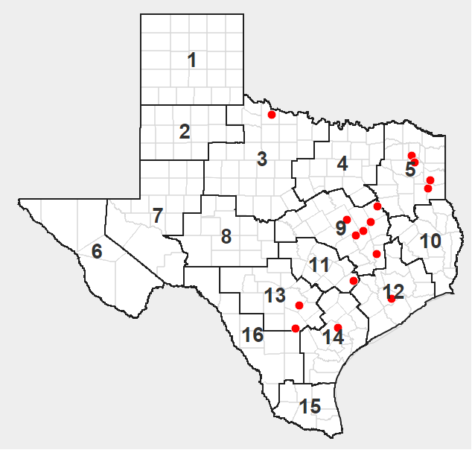
CCR sites
Notes:
Surveyed a couple of times: called to see if rule applied, latest contact information, gw wells and/or liner type.
16 sites with SWRs that this impacts
CCR use in Texas - use in Texas
TCEQ Technical Guidance – Some sites already are following guidance and have monitoring wells, geo technical liners or clay liners for landfills or impoundments.

Slide 33
EPA CCR Rule Link
Rule Summary
Final Rule
Webinar Slides
http://www2.epa.gov/coalash/coal-ash-rule
Notes:
Sign up for GovDelivery – interested parties

Slide 34
Sign up for GovDelivery
To Receive notification of IHW form, guidance, and procedure updates:
http://www.tceq.texas.gov/permitting/waste_permits/ihw_permits/signupihw
Notes:
Sign up for GovDelivery – interested parties

Slide 35
How to Contact Us
Texas Commission on Environmental Quality
Industrial & Hazardous Waste Permits Section,
P. O. Box 13087 MC-130
Austin, TX 78711-3087
Phone: 512-239-2335
Fax: 512-239-6383
E-Mail: IHWPER@TCEQ.TEXAS.GOV
Notes:
For technical information contact Mary Talley 6624 or Vahab Haghighatian 6081 after

